Slide 1

Computer Networking: A Top Down Approach
Seventh Edition
Chapter 1
Introduction
Slides in this presentation contain hyperlinks. JAWS users should be able to get a list of links by using INSERT+F7
Copyright © 2017, 2013, 2010 Pearson Education, Inc. All Rights Reserved
Notes:
If this PowerPoint presentation contains mathematical equations, you may need to check that your computer has the following installed:
1) MathType Plugin
2) Math Player (free versions available)
3) NVDA Reader (free versions available)

Slide 2
Introduction (1 of 2)
Our Goal:
get “feel” and terminology
more depth, detail later in course
approach:
use Internet as example

Slide 3
Introduction (2 of 2)
Overview:
What’s the Internet?
What’s a protocol?
network edge; hosts, access net, physical media
network core: packet/circuit switching, Internet structure
performance: loss, delay, throughput
security
protocol layers, service models
history

Slide 4
Learning Objectives (1 of 7)
1.1 what is the Internet?
1.2 network edge
end systems, access networks, links
1.3 network core
packet switching, circuit switching, network structure
1.4 delay, loss, throughput in networks
1.5 protocol layers, service models
1.6 networks under attack: security
1.7 history

Slide 5
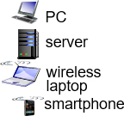
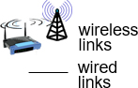

What’s the Internet: “Nuts and Bolts” View (1 of 2)
billions of connected computing devices:
hosts = end systems
running network apps
communication links
fiber, copper, radio, satellite
transmission rate: bandwidth
packet switches: forward packets (chunks of data)
routers and switches

Slide 6
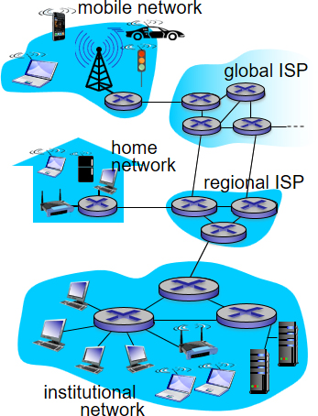
What’s the Internet: “Nuts and Bolts” View (2 of 2)

Slide 7


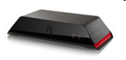



“Fun” Internet-Connected Devices
Web-enabled toaster +
weather forecaster
IP picture frame
http://www.ceiva.com/
Tweet-a-watt:
monitor energy use
Slingbox: watch,
control cable TV remotely
sensorized,
bed
mattress
Internet
refrigerator
Internet phones

Slide 8

What’s the Internet: “Nuts and Bolts” View
Internet: “network of networks”
Interconnected I S Ps
protocols control sending, receiving of messages
e.g., T C P, I P, H T T P, Skype, 802.11
Internet standards
R F C: Request for comments
I E T F: Internet Engineering Task Force

Slide 9
What’s the Internet: A Service View
infrastructure that provides services to applications:
Web, VoI P, email, games, e-commerce, social nets, …
provides programming interface to apps
hooks that allow sending and receiving app programs to “connect” to Internet
provides service options, analogous to postal service

Slide 10
What’s a Protocol? (1 of 2)
human protocols:
“what’s the time?”
“I have a question”
introductions
… specific messages sent
… specific actions taken when messages received, or other events
network protocols:
machines rather than humans
all communication activity in Internet governed by protocols
protocols define format, order of messages sent and received among network entities, and actions taken on message transmission, receipt

Slide 11
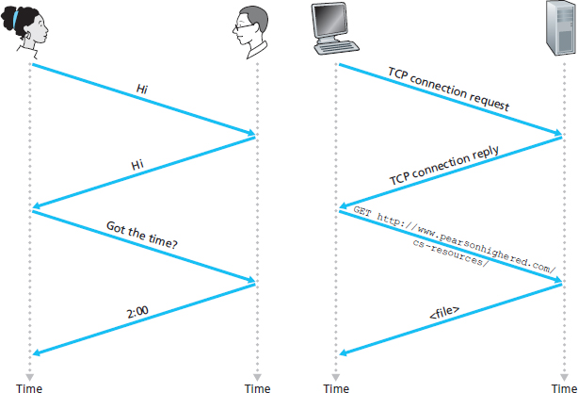
What’s a Protocol? (2 of 2)
A human protocol and a computer network protocol:
Q: other human protocols?

Slide 12
Learning Objectives (2 of 7)
1.1 what is the Internet?
1.2 network edge
end systems, access networks, links
1.3 network core
packet switching, circuit switching, network structure
1.4 delay, loss, throughput in networks
1.5 protocol layers, service models
1.6 networks under attack: security
1.7 history

Slide 13

A Closer Look at Network Structure:
network edge:
hosts: clients and servers
servers often in data centers
access networks, physical media: wired, wireless communication links
network core:
interconnected routers
network of networks

Slide 14
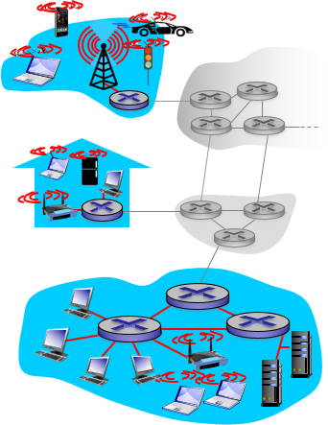
Access Networks and Physical Media
Q: How to connect end systems to edge router?
residential access nets
institutional access networks (school, company)
mobile access networks
keep in mind:
bandwidth (bits per second) of access network?
shared or dedicated?

Slide 15
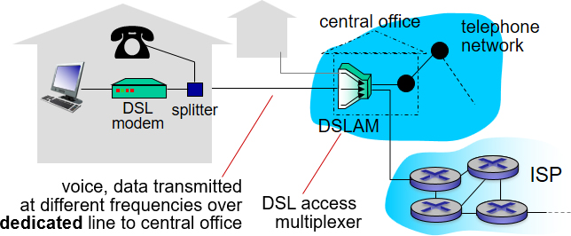
Access Network: Digital Subscriber Line (D S L) (1 of 2)

Slide 16
Access Network: Digital Subscriber Line (D S L) (2 of 2)
use existing telephone line to central office D S L A M
data over D S L phone line goes to Internet
voice over D S L phone line goes to telephone net
< 2.5 M b p s upstream transmission rate (typically < 1 M b p s)
< 24 M b p s downstream transmission rate (typically < 10 M b p s)

Slide 17
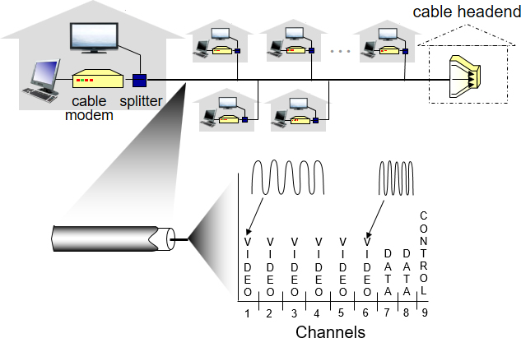
Access Network: Cable Network (1 of 3)
frequency division multiplexing: different channels transmitted in different frequency bands

Slide 18
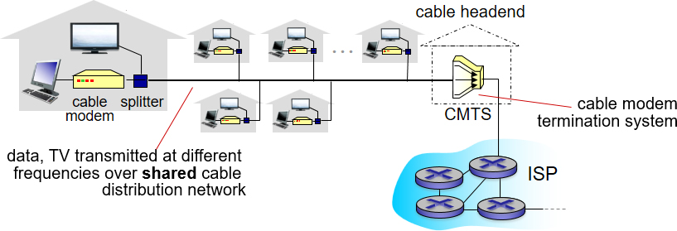
Access Network: Cable Network (2 of 3)

Slide 19
Access Network: Cable Network (3 of 3)
H F C: hybrid fiber coax
asymmetric: up to 30M b p s downstream transmission rate, 2 M b p s upstream transmission rate
network of cable, fiber attaches homes to I S P router
homes share access network to cable headend
unlike D S L, which has dedicated access to central office

Slide 20
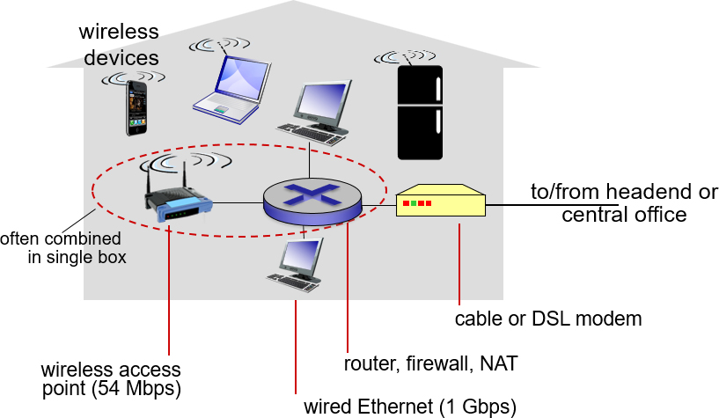
Access Network: Home Network

Slide 21
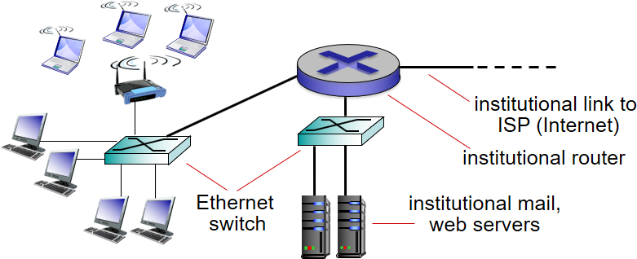
Enterprise Access Networks (Ethernet)
typically used in companies, universities, etc.
10 M b p s, 100M b p s, 1G b p s, 10G b p s transmission rates
today, end systems typically connect into Ethernet switch

Slide 22
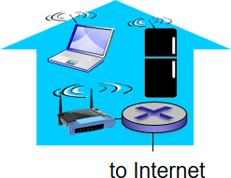
Wireless Access Networks (1 of 2)
shared wireless access network connects end system to router
via base station aka “access point”
wireless L A Ns:
within building (100 ft.)
802.11b/g/n (WiFi): 11, 54, 450 M b p s transmission rate

Slide 23
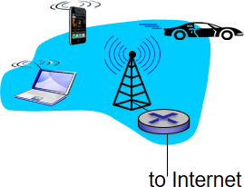
Wireless Access Networks (2 of 2)
wide-area wireless access
provided by telco (cellular) operator, 10’s kilometre
between 1 and 10 M b p s
3G, 4G: L T E

Slide 24
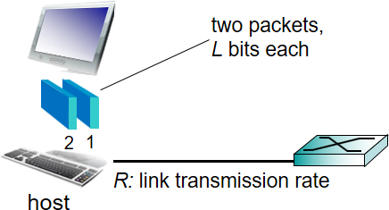
Host: Sends Packets of Data
host sending function:
takes application message
breaks into smaller chunks, known as packets, of length L bits
transmits packet into access network at transmission rate R
link transmission rate, aka link capacity, aka link bandwidth

Slide 25
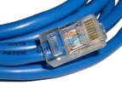
Physical Media
bit: propagates between transmitter/receiver pairs
physical link: what lies between transmitter & receiver
guided media:
signals propagate in solid media: copper, fiber, coax
unguided media:
signals propagate freely, e.g., radio
twisted pair (T P)
two insulated copper wires
Category 5: 100 M b p s, 1 G b p s Ethernet
Category 6: 10G b p s

Slide 26

Physical Media: Coax, Fiber (1 of 2)
Coaxial Cable:
two concentric copper conductors
bidirectional
broadband:
multiple channels on cable
H F C

Slide 27

Physical Media: Coax, Fiber (2 of 2)
Fiber Optic Cable:
glass fiber carrying light pulses, each pulse a bit
high-speed operation:
high-speed point-to-point transmission (e.g., 10’s-100’s G b p s transmission rate)
low error rate:
repeaters spaced far apart
immune to electromagnetic noise

Slide 28
Physical Media: Radio (1 of 2)
signal carried in electromagnetic spectrum
no physical “wire”
bidirectional
propagation environment effects:
reflection
obstruction by objects
interference

Slide 29
Physical Media: Radio (2 of 2)
Radio Link Types:
terrestrial microwave
e.g. up to 45 M b p s channels
L A N (e.g., WiFi)
54 M b p s
wide-area (e.g., cellular)
4G cellular: ~ 10 M b p s
Satellite
K b p s to 45M b p s channel (or multiple smaller channels)
270 millisec end-end delay
geosynchronous versus low altitude

Slide 30
Learning Objectives (3 of 7)
1.1 what is the Internet?
1.2 network edge
end systems, access networks, links
1.3 network core
packet switching, circuit switching, network structure
1.4 delay, loss, throughput in networks
1.5 protocol layers, service models
1.6 networks under attack: security
1.7 history

Slide 31
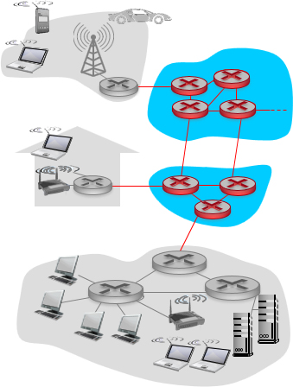
The Network Core
mesh of interconnected routers
packet-switching: hosts break application-layer messages into packets
forward packets from one router to the next, across links on path from source to destination
each packet transmitted at full link capacity

Slide 32
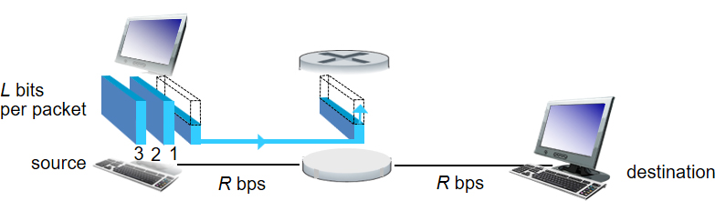
Packet-Switching: Store-and-Forward (1 of 3)

Slide 33
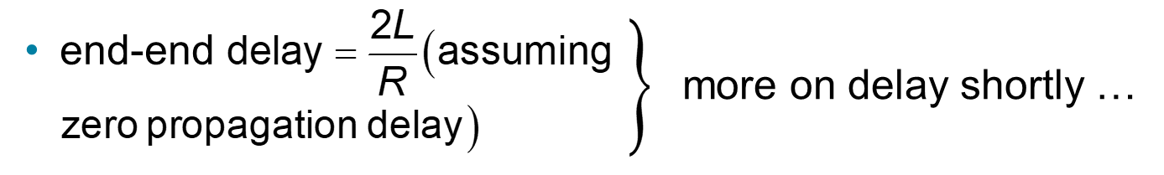
Packet-Switching: Store-and-Forward (2 of 3)
takes
seconds to transmit (push out) L-bit packet into
link at R bps
store and forward: entire packet must arrive at router before it can be transmitted on next link

Slide 34
Packet-Switching: Store-and-Forward (3 of 3)
one-hop numerical example:
L = 7.5 Mbits
R = 1.5 M b p s
one-hop transmission delay = 5 sec

Slide 35
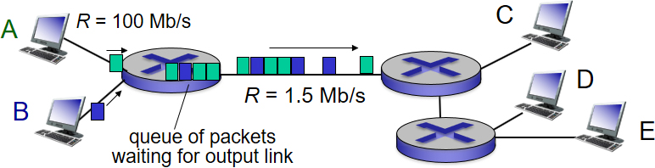
Packet Switching: Queueing Delay, Loss
queuing and loss:
if arrival rate (in bits) to link exceeds transmission rate of link for a period of time:
packets will queue, wait to be transmitted on link
packets can be dropped (lost) if memory (buffer) fills up

Slide 36
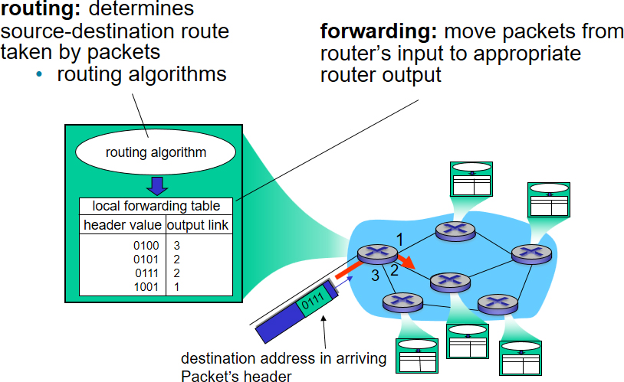
Two Key Network-Core Functions

Slide 37
Alternative Core: Circuit Switching (1 of 2)
end-end resources allocated to, reserved for “call” between source & dest:
in diagram, each link has four circuits.
call gets 2nd circuit in top link and 1st circuit in right link.
dedicated resources: no sharing
circuit-like (guaranteed) performance
circuit segment idle if not used by call (no sharing)
commonly used in traditional telephone networks

Slide 38
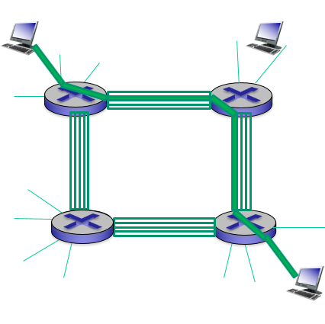
Alternative Core: Circuit Switching (2 of 2)

Slide 39
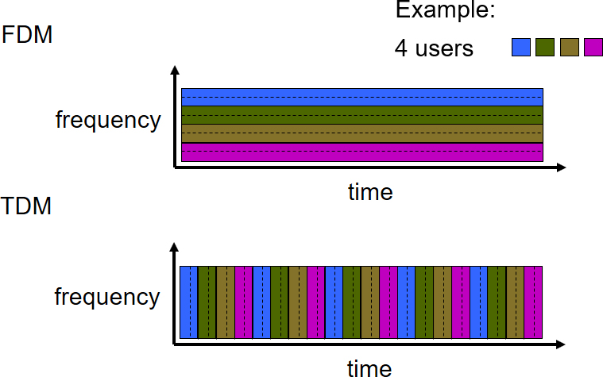
Circuit Switching: F D M Versus T D M
Notes:
Two simple multiple access control techniques.
Each mobile’s share of the bandwidth is divided into portions for the uplink and the downlink. Also, possibly, out of band signaling.
As we will see, used in AMPS, GSM, IS-54/136

Slide 40
Packet Switching Versus Circuit Switching (1 of 4)
packet switching allows more users to use network!
example:
1 M b/s link
each user:
100 k b/s when “active”
active 10% of time
circuit-switching:
10 users

Slide 41
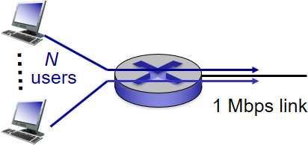
Packet Switching Versus Circuit Switching (2 of 4)
packet switching:
with 35 users, probability > 10 active at same time is less than .0004 *
Q: how did we get value 0.0004?
Q: what happens if > 35 users ?
* Check out the online interactive exercises for more examples: http://gaia.cs.umass.edu/kurose_ross/interactive/

Slide 42
Packet Switching Versus Circuit Switching (3 of 4)
is packet switching a “slam dunk winner?”
great for bursty data
resource sharing
simpler, no call setup
excessive congestion possible: packet delay and loss
protocols needed for reliable data transfer, congestion control

Slide 43
Packet Switching Versus Circuit Switching (4 of 4)
Q: How to provide circuit-like behavior?
bandwidth guarantees needed for audio/video apps
still an unsolved problem (chapter 7)
Q: human analogies of reserved resources (circuit switching) versus on-demand allocation (packet-switching)?

Slide 44
Internet Structure: Network of Networks (1 of 10)
End systems connect to Internet via access I S P s (Internet Service Providers)
residential, company and university I S P s
Access I S Ps in turn must be interconnected.
so that any two hosts can send packets to each other
Resulting network of networks is very complex
evolution was driven by economics and national policies
Let’s take a stepwise approach to describe current Internet structure

Slide 45
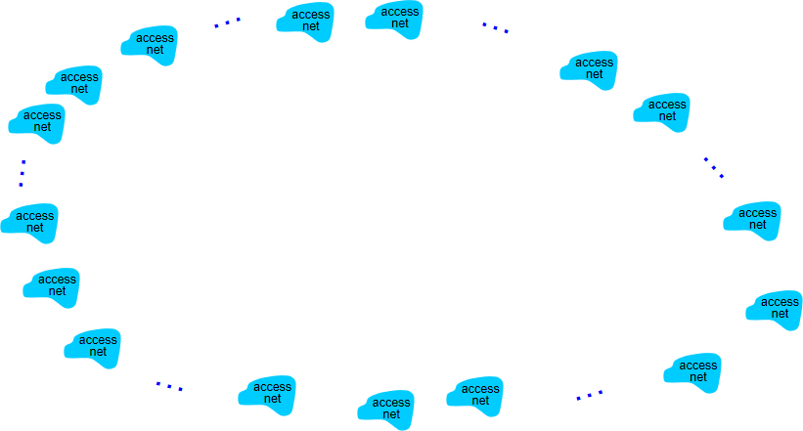
Internet Structure: Network of Networks (2 of 10)
Question: given millions of access I S P s, how to connect them together?

Slide 46
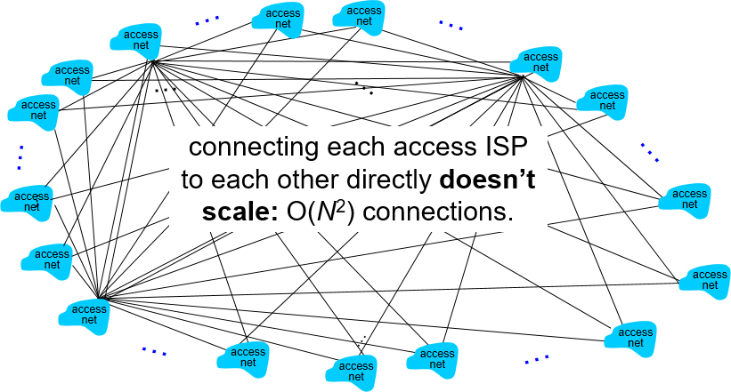
Internet Structure: Network of Networks (3 of 10)
Option: connect each access I S P to every other access I S P?

Slide 47
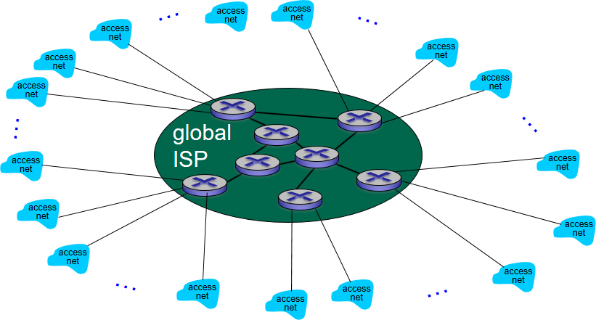
Internet Structure: Network of Networks (4 of 10)
Option: connect each access I S P to one global transit I S P?
Customer and provider I S P s have economic agreement.

Slide 48
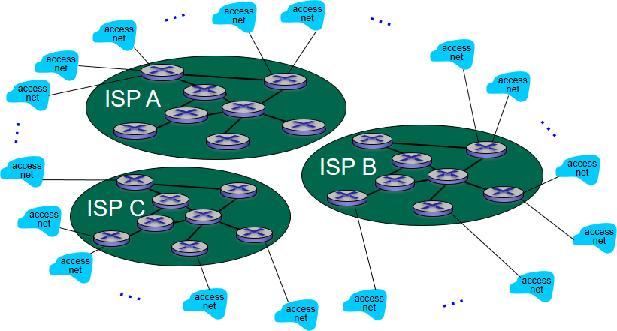
Internet Structure: Network of Networks (5 of 10)
But if one global I S P is viable business, there will be competitors ….

Slide 49
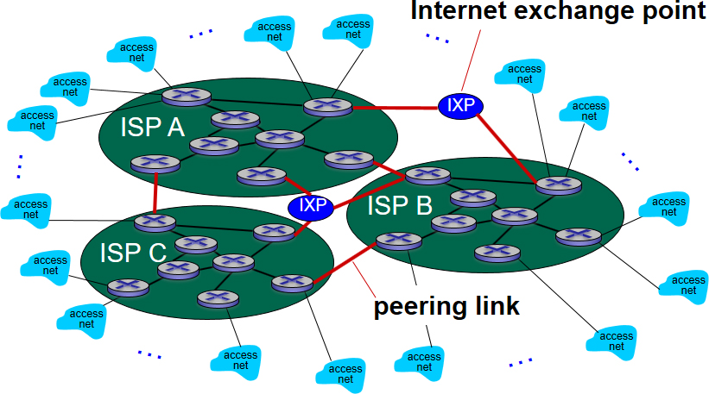
Internet Structure: Network of Networks (6 of 10)
But if one global I S P is viable business, there will be competitors …. which must be interconnected

Slide 50
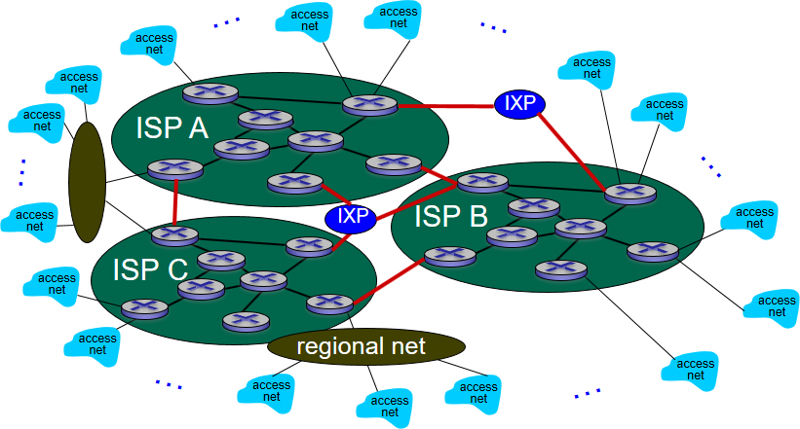
Internet Structure: Network of Networks (7 of 10)
… and regional networks may arise to connect access nets to I S Ps

Slide 51
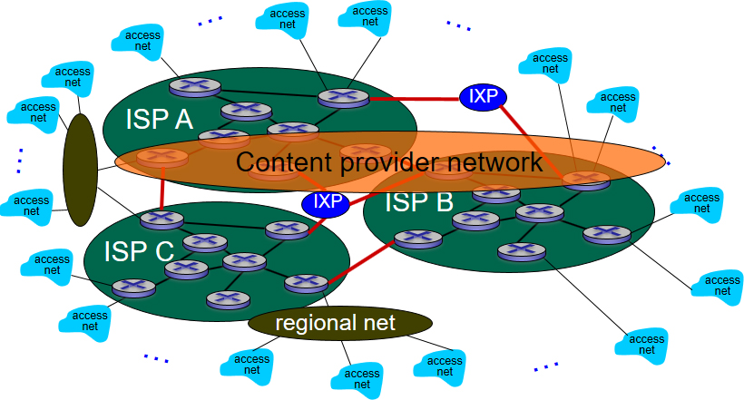
Internet Structure: Network of Networks (8 of 10)
… and content provider networks (e.g., Google, Microsoft, Akamai) may run their own network, to bring services, content close to end users

Slide 52
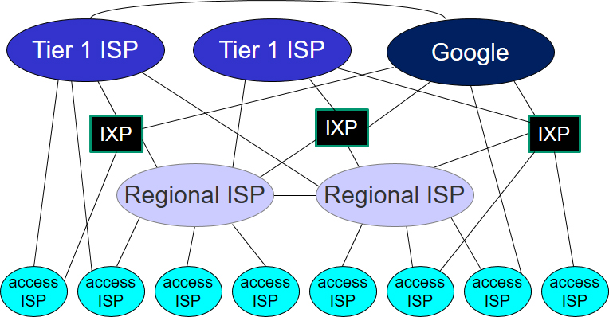
Internet Structure: Network of Networks (9 of 10)

Slide 53
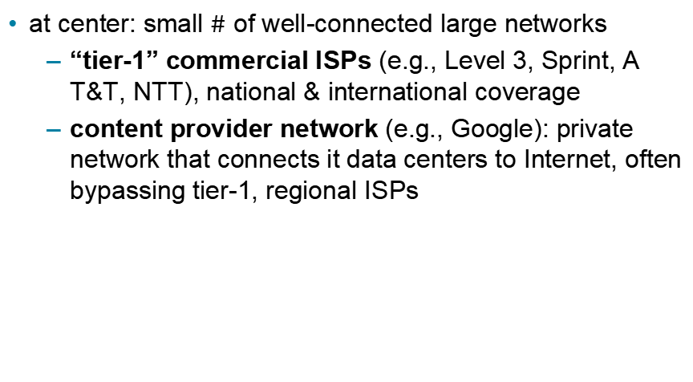
Internet Structure: Network of Networks (10 of 10)
at center: small $\#$ of well-connected large networks
“tier-1” commercial I S Ps (e.g., Level 3, Sprint, A T&T, N T T), national & international coverage
content provider network (e.g., Google): private network that connects it data centers to Internet, often bypassing tier-1, regional I S Ps

Slide 54
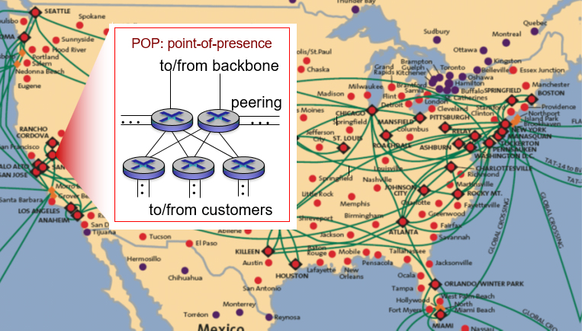
Tier-I I S P: e.g., Sprint

Slide 55
Learning Objectives (4 of 7)
1.1 what is the Internet?
1.2 network edge
end systems, access networks, links
1.3 network core
packet switching, circuit switching, network structure
1.4 delay, loss, throughput in networks
1.5 protocol layers, service models
1.6 networks under attack: security
1.7 history

Slide 56
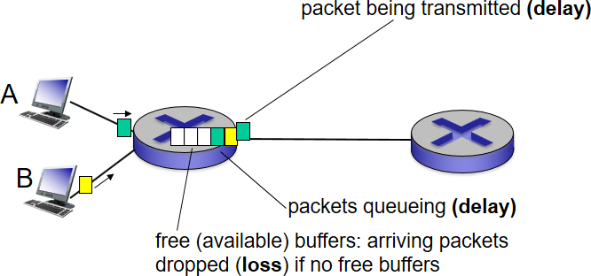
How Do Loss and Delay Occur?
packets queue in router buffers
packet arrival rate to link (temporarily) exceeds output link capacity
packets queue, wait for turn

Slide 57
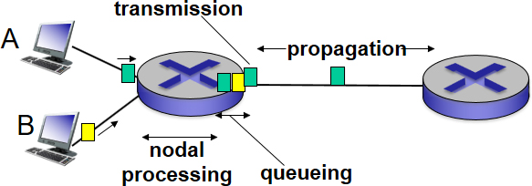
Four Sources of Packet Delay (1 of 4)

Slide 58
Four Sources of Packet Delay (2 of 4)
d_{proc}: nodal processing
check bit errors
determine output link
typically < millisec
d_{queue}: queueing delay
time waiting at output link for transmission
depends on congestion level of router

Slide 59
Four Sources of Packet Delay (3 of 4)

Slide 60
Four Sources of Packet Delay (4 of 4)
d_{trans}: transmission delay:
L: packet length (bits)
R: link bandwidth (b p s)
d_{prop}
* Check out the online interactive exercises for more examples: http://gaia.cs.umass.edu/kurose_ross/interactive/
d_{trans}
d_{prop}: propagation delay:
d: length of physical link
* Check out the Java applet for an interactive animation on trans versus prop delay
s: propagation speed

Slide 61
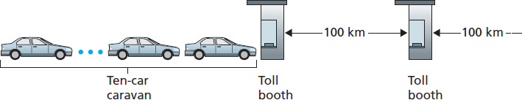
Caravan Analogy (1 of 3)
cars “propagate” at
toll booth takes 12 sec to service car (bit transmission time)
car ~ bit; caravan ~ packet
Q: How long until caravan is lined up before 2nd toll booth?

Slide 62
Caravan Analogy (2 of 3)
time to “push” entire caravan through toll booth onto highway = 12×10 = 120 sec
time for last car to propagate from 1st to 2nd toll both:
A: 62 minutes

Slide 63
Caravan Analogy (3 of 3)
suppose cars now “propagate” at
and suppose toll booth now takes one min to service a car
Q: Will cars arrive to 2nd booth before all cars serviced at first booth?
A: Yes! after 7 min, first car arrives at second booth; three cars still at first booth

Slide 64
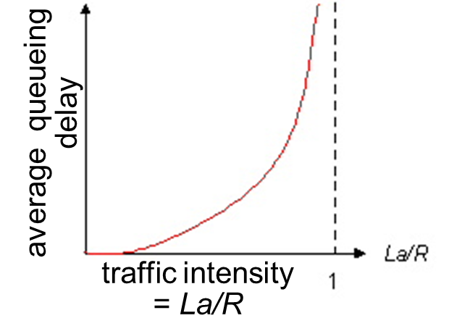
Queueing Delay (Revisited) (1 of 2)
R: link bandwidth (b p s)
L: packet length (bits)
a: average packet arrival rate

Slide 65

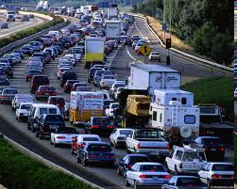
Queueing Delay (Revisited) (2 of 2)
than can be serviced, average delay infinite!

Slide 66
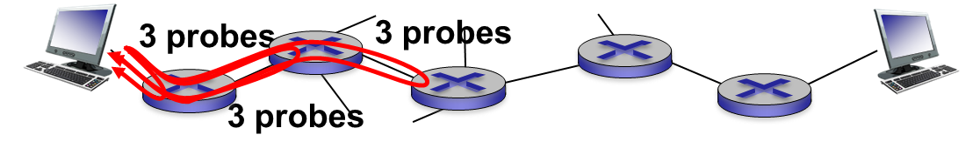
“Real” Internet Delays and Routes
what do “real” Internet delay & loss look like?
traceroute program: provides delay measurement from source to router along end-end Internet path towards destination. For all i:
sends three packets that will reach router i on path towards destination
router i will return packets to sender
sender times interval between transmission and reply.

Slide 67
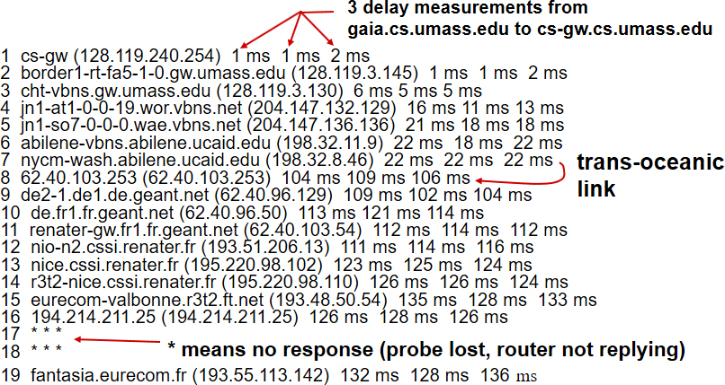
“Real” Internet Delays, Routes
Traceroute: gaia.cs.umass.edu to www.eurecom.fr
* Do some traceroutes from exotic countries at www.traceroute.org

Slide 68
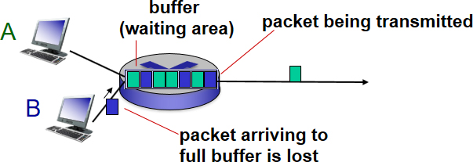
Packet Loss
queue (aka buffer) preceding link in buffer has finite capacity
packet arriving to full queue dropped (aka lost)
lost packet may be retransmitted by previous node, by source end system, or not at all

Slide 69
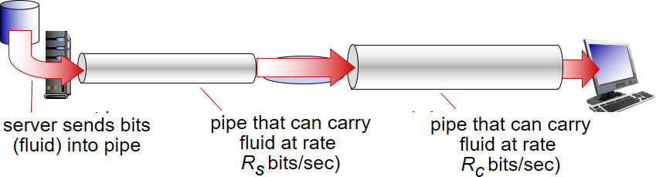
Throughput (1 of 2)
throughput: rate (bits/time unit) at which bits transferred between sender/receiver
instantaneous: rate at given point in time
average: rate over longer period of time

Slide 70
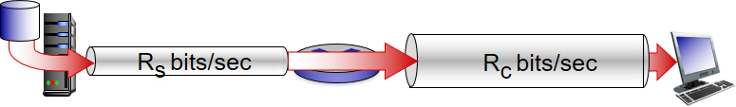
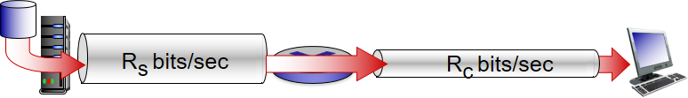
Throughput (2 of 2)
R_{s} < R_{c} What is average end-end throughput?
R_{s} > R_{c} What is average end-end throughput?
bottleneck link
link on end-end path that constrains end-end throughput

Slide 71
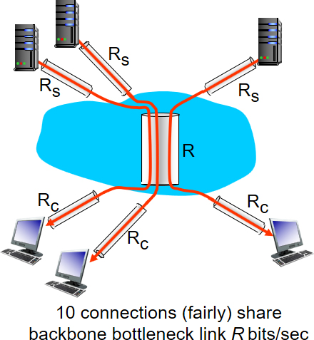
Throughput: Internet Scenario
per-connection end-end throughput:
in practice: R_{c} or R_{s} is often bottleneck
* Check out the online interactive exercises for more examples: http://gaia.cs.umass.edu/kurose_ross/interactive/

Slide 72
Learning Objectives (5 of 7)
1.1 what is the Internet?
1.2 network edge
end systems, access networks, links
1.3 network core
packet switching, circuit switching, network structure
1.4 delay, loss, throughput in networks
1.5 protocol layers, service models
1.6 networks under attack: security
1.7 history

Slide 73
Protocol “Layers”
Networks are complex,
with many “pieces”:
Hosts
Routers
Links of various media
Applications
Protocols
Hardware, software
Question:
is there any hope of organizing structure of network?
…. or at least our discussion of networks?

Slide 74
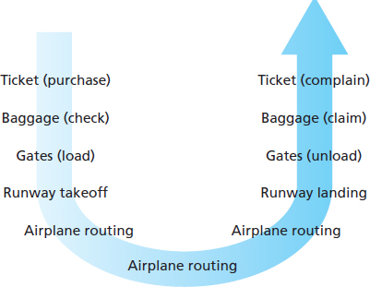
Organization of Air Travel
A Series of Steps

Slide 75
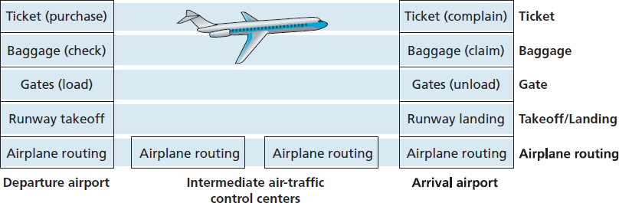
Layering of Airline Functionality
layers: each layer implements a service
via its own internal-layer actions
relying on services provided by layer below

Slide 76
Why Layering?
dealing with complex systems:
explicit structure allows identification, relationship of complex system’s pieces
layered reference model for discussion
modularization eases maintenance, updating of system
change of implementation of layer’s service transparent to rest of system
e.g., change in gate procedure doesn’t affect rest of system
layering considered harmful?

Slide 77
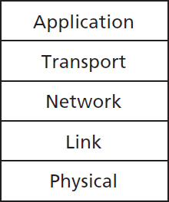
Internet Protocol Stack
application: supporting network applications
F T P, S M T P, H T T P
transport: process-process data transfer
T C P, U D P
network: routing of datagrams from source to destination
I P, routing protocols
link: data transfer between neighboring network elements
Ethernet, 802.111 (WiFi), P P P
physical: bits “on the wire”

Slide 78
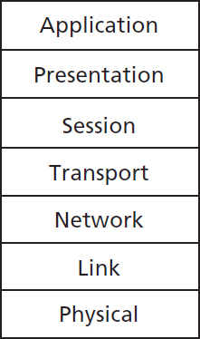
I S O/O S I Reference Model
presentation: allow applications to interpret meaning of data, e.g., encryption, compression, machine-specific conventions
session: synchronization, checkpointing, recovery of data exchange
Internet stack “missing” these layers!
these services, if needed, must be implemented in application
needed?

Slide 79
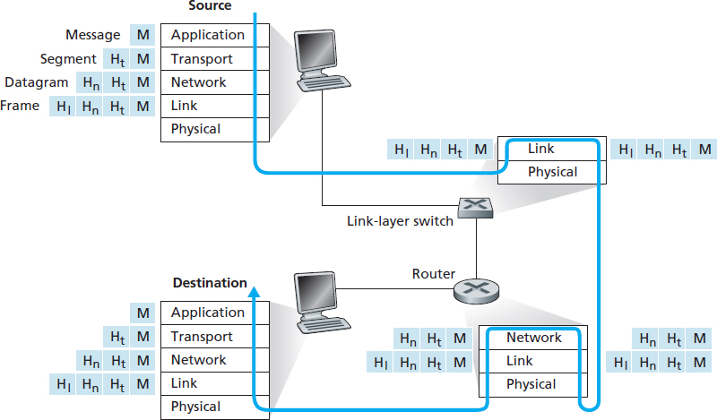
Encapsulation

Slide 80
Learning Objectives (6 of 7)
1.1 what is the Internet?
1.2 network edge
end systems, access networks, links
1.3 network core
packet switching, circuit switching, network structure
1.4 delay, loss, throughput in networks
1.5 protocol layers, service models
1.6 networks under attack: security
1.7 history

Slide 81

Network Security
field of network security:
how bad guys can attack computer networks
how we can defend networks against attacks
how to design architectures that are immune to attacks
Internet not originally designed with (much) security in mind
original vision: “a group of mutually trusting users
attached to a transparent network”
Internet protocol designers playing “catch-up”
security considerations in all layers!

Slide 82
Bad Guys: Put Malware into Hosts via Internet
malware can get in host from:
virus: self-replicating infection by receiving/executing object (e.g., e-mail attachment)
worm: self-replicating infection by passively receiving object that gets itself executed
spyware malware can record keystrokes, web sites visited, upload info to collection site
infected host can be enrolled in botnet, used for spam. D D o S attacks

Slide 83

Bad Guys: Attack Server, Network Infrastructure
Denial of Service (D o S): attackers make resources (server, bandwidth) unavailable to legitimate traffic by overwhelming resource with bogus traffic
select target
break into hosts around the network (see botnet)
send packets to target from compromised hosts

Slide 84

Bad Guys Can Sniff Packets
packet “sniffing”:
broadcast media (shared Ethernet, wireless)
promiscuous network interface reads/records all packets (e.g., including passwords!) passing by
wireshark software used for end-of-chapter labs is a (free) packet-sniffer

Slide 85

Bad Guys Can Use Fake Addresses
I P spoofing: send packet with false source address
… lots more on security (throughout, Chapter 8)

Slide 86
Learning Objectives (7 of 7)
1.1 what is the Internet?
1.2 network edge
end systems, access networks, links
1.3 network core
packet switching, circuit switching, network structure
1.4 delay, loss, throughput in networks
1.5 protocol layers, service models
1.6 networks under attack: security
1.7 history

Slide 87
Internet History (1 of 9)
1961-1972: Early packet-switching principles
1961: Kleinrock - queueing theory shows effectiveness of packet-switching
1964: Baran - packet-switching in military nets
1967: A R P Anet conceived by Advanced Research Projects Agency
1969: first A R P Anet node operational

Slide 88

Internet History (2 of 9)
1972:
A R P Anet public demo
N C P (Network Control Protocol) first host-host protocol
first e-mail program
A R P Anet has 15 nodes

Slide 89
Internet History (3 of 9)
1972-1980: Internetworking, new and proprietary nets
1970: A L O H Anet satellite network in Hawaii
1974: Cerf and Kahn - architecture for interconnecting networks
1976: Ethernet at Xerox P A R C
Late70’s: proprietary architectures: D E Cnet, S N A, X N A
late 70’s: switching fixed length packets (A T M precursor)
1979: A R P Anet has 200 nodes

Slide 90
Internet History (4 of 9)
Cerf and Kahn’s internetworking principles:
minimalism, autonomy - no internal changes required to interconnect networks
best effort service model
stateless routers
decentralized control
define today’s Internet architecture

Slide 91
Internet History (5 of 9)
1980-1990: new protocols, a proliferation of networks
1983: deployment of T C P/I P
1982: smtp e-mail protocol defined
1983: D N S defined for name-to-I P-address translation
1985: ftp protocol defined
1988: T C P congestion control
new national networks: C Snet, B I Tnet, N S Fnet, Minitel
100,000 hosts connected to confederation of networks

Slide 92
Internet History (6 of 9)
1990, 2000’s: commercialization, the Web, new apps
early 1990’s: A R P Anet decommissioned
1991: N S F lifts restrictions on commercial use of N S Fnet (decommissioned, 1995)
early 1990s: Web
hypertext [Bush 1945, Nelson 1960’s]
H T M L, H T T P: Berners-Lee
1994: Mosaic, later Netscape
late 1990’s: commercialization of the Web

Slide 93
Internet History (7 of 9)
late 1990’s – 2000’s:
more killer apps: instant messaging, P2P file sharing
network security to forefront
est. 50 million host, 100 million+ users
backbone links running at G b p s

Slide 94
Internet History (8 of 9)
2005-present
~5B devices attached to Internet (2016)
smartphones and tablets
aggressive deployment of broadband access
increasing ubiquity of high-speed wireless access

Slide 95
Internet History (9 of 9)
emergence of online social networks:
Facebook: ~ one billion users
service providers (Google, Microsoft) create their own networks
bypass Internet, providing “instantaneous” access to search, video content, email, etc.
e-commerce, universities, enterprises running their services in “cloud” (e.g., Amazon E C2)

Slide 96
Introduction: Summary (1 of 2)
covered a “ton” of material!
Internet overview
What’s a protocol?
network edge, core, access network
packet-switching versus circuit-switching
Internet structure

Slide 97
Introduction: Summary (2 of 2)
performance: loss, delay, throughput
layering, service models
security
history
you now have:
context, overview, “feel” of networking
more depth, detail to follow!

Slide 98
Chapter 1

Slide 99

Additional Slides

Slide 100

Copyright

